Slide 1
Key Challenges Must Be Addressed to Secure IoT Systems
Insecure Devices
Supply Chain Insecurities
Lack of Visibility
Vendors still shipping devices with weaknesses – hardcoded passwords, keys; vulnerable network services
Libraries embedded within devices may have new vulnerabilities identified years later
Devices continue to be hidden on the network
Asset tracking continues to be a problem
Lack of Integrated IAM Solutions
Non-Standard Patch / Firmware Update Processes
Limited Security Features
Difficult to leverage a single identity management or key management infrastructure
Firmware updates highly vendor dependent; maybe secure maybe not
IoT devices may be designed using legacy technology and limited processing capabilities.
Security engineers may be hampered in their ability to install security software directly onto devices.
Some devices may not even be able to generate and store audit logs

Slide 2
Risk Impact Increases with Reliance on IoT Capabilities
IoT a fundamental building block for complex systems of systems
Integrated with other technologies (ml, analytics, robotics) to as foundation for safety-critical use cases
Automation (industrial, transportation)
Preventive Maintenance
Healthcare Diagnostics
IoT at the edge enabled through 5G
Local pre-processing / enrichment of data
Reach-back to the cloud (digital twins, etc)
IoT embedded into many systems

Slide 3
The IoT Control Matrix
A set of cyber security controls that can be applied within an an enterprise IoT security program
Controls broken into domains and sub-domains
Controls allocated to specific architectural elements within a typical IoT system
Device
Gateway
Network
Cloud
Controls type (e.g., preventive / detective) and frequency (event, continuous, etc) specified
References provided for each control

Slide 4
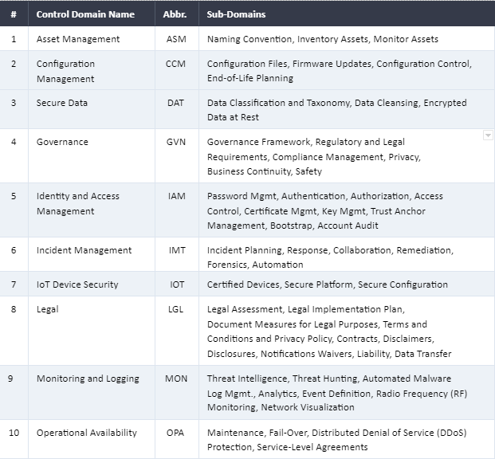
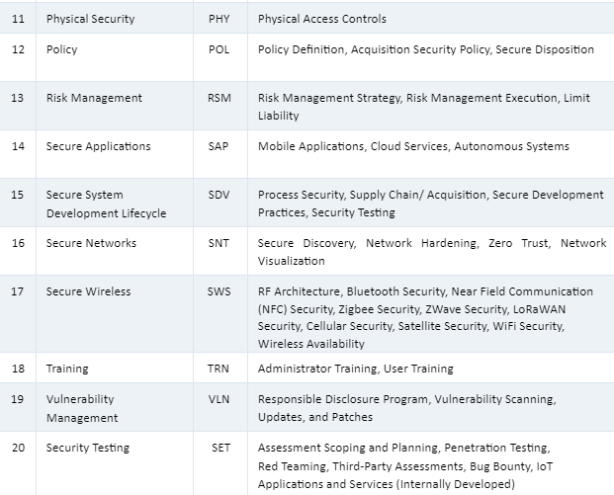
IoTCM Control Domains and Sub-Domains

Slide 5
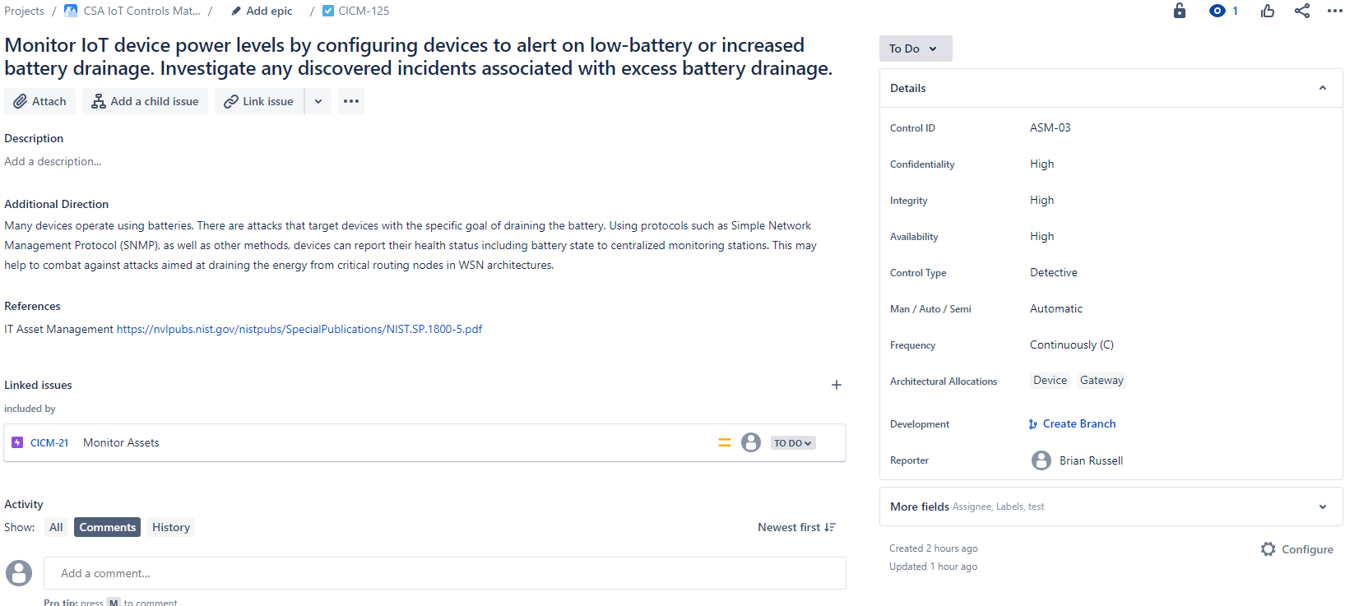
Control Example – Monitor IoT Device Power Levels

Slide 6
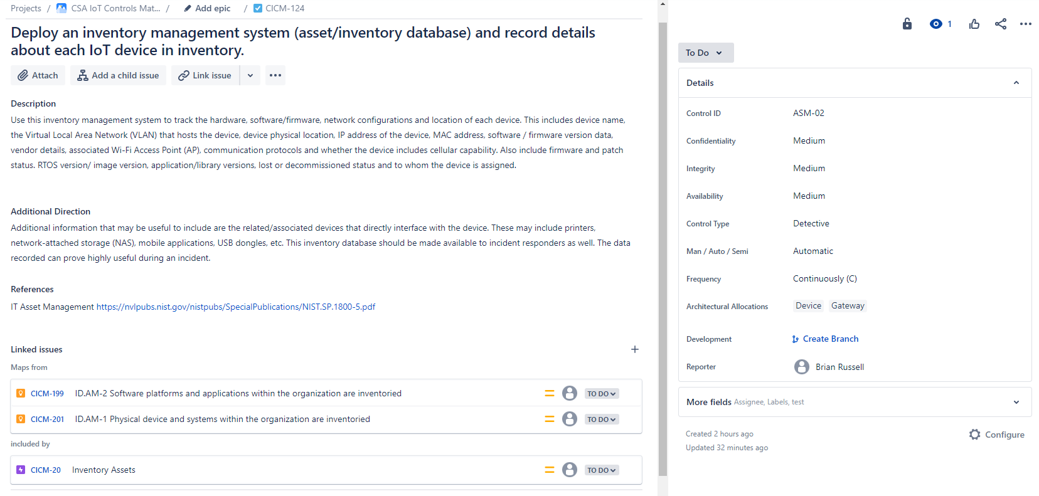
Control Example – Deploy Inventory Management System

Slide 7
Tailoring the IoT Controls Matrix
IoTCM Controls are meant to be tailorable
Define your system Confidentiality, Integrity and Availability Impact Levels
Review Controls – Identify outliers and remove
Tailor to your system architecture
Apply controls to specific architectural elements to form a backlog per element type
Allocate to specific security programs
Plan for control implementation approach
Manual/automatic/semi
Frequency
Identify and decide on residual risk (accept, plan, implement compensating controls

